Slide 1
PV System Analysis For Tracking System Losses and Technology Comparisons
Bruce King
10th PV Performance Modeling Workshop
1 March, 2018
SAND2018-4929C

Slide 2
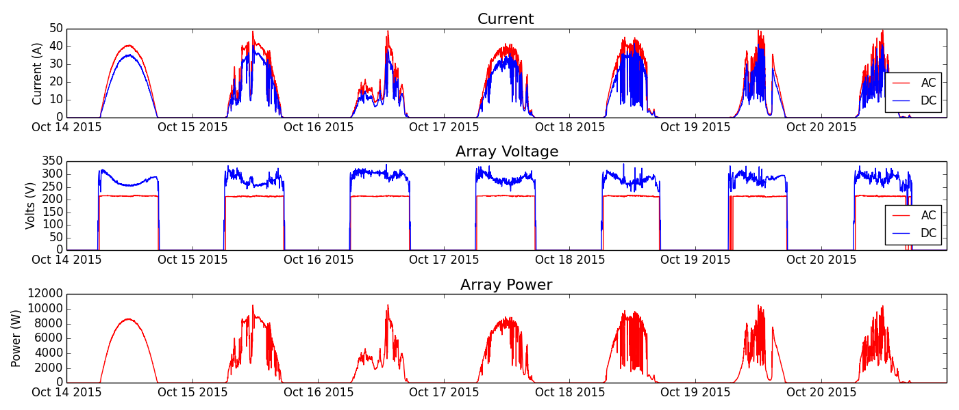
Performance Monitoring
Ambitious module lifetime goals (e.g. 50 years) requires that PV systems maintain their predicted performance over time…how to validate claims?
Side-by-side technology comparisons require normalization methods to avoid unintentional bias or misinterpretation of results
Careful performance monitoring coupled with appropriate analysis can help with both
Will present a methodology under development at Sandia to achieve this

Slide 3
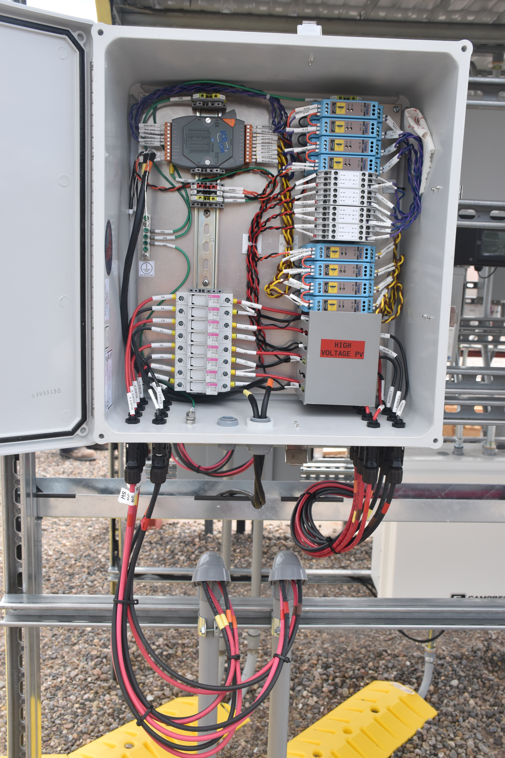
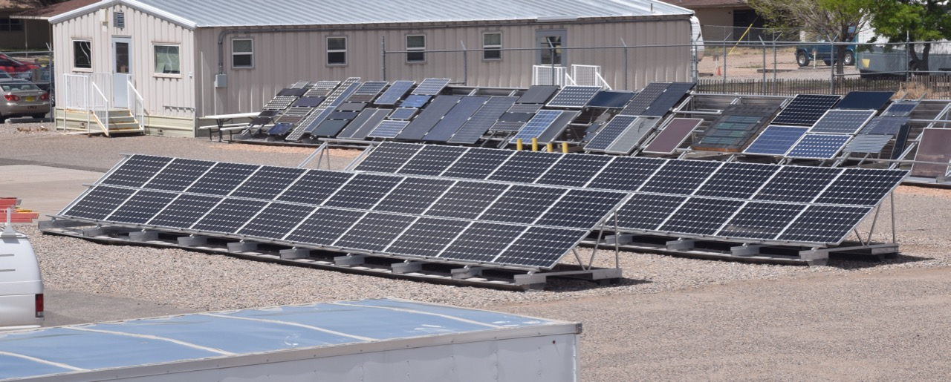
Baseline System at Sandia
Suniva mono-Si modules (3kW)
DC monitoring of string current and voltage (1-min avg)
POA irradiance using broadband pyranometer (CMP-11)
Other relevant data from local met station
 | Module | System
Module | Suniva Optimus Mono
Inverter | SMA SB 3800TL
String length | 12 modules
Strings | 1
Pmp | 270 | 3240
Voc | 38.4 | 460
Vmp | 31 | 372
Isc | 9.18 | 9.18
Imp | 8.7 | 8.7

Slide 4
Performance Ratio Defined (IEC 61724)
PR: ratio of actual energy produced to reference energy. Includes overall effect of losses including temperature and other inefficiencies. k = time interval of interest (e.g. 1 month)
PR-STC: As above, but Array Power Rating is adjusted for module temperature.
PR-PPI: Power Performance Index, ratio of actual power produced to predicted power from a performance model run using actual met conditions

Slide 5
Performance Ratio Considerations
PR: What to use for array power rating?
Two choices – “nameplate” or independently measured module power
Nameplate – will reveal accuracy in manufacturer assigned power rating
Independent – will show regional and seasonal variation without bias.
PR-STC: As above, but with choice of temperature coefficient for power (spec sheet vs. independent)
PR-PPI: Choice of model, source of calibration values

Slide 6
Other important considerations
Measured Power/Energy: AC or DC?
POA Irradiance: Reference cell, Pyranometer, or Effective Irradiance?
Temperature: Measured or modeled?
Data filtering
  Time of day filters?
  Solar position filters?
  Clear-sky filters?
  Stable condition filters?
If different parties use different inputs, results of performance monitoring will be different and should not be compared.

Slide 7
Example RTC Analysis Steps
Process Weather data
1-minute weather data retrieved from database
Calculate Sun Position and remove night-time
Calculate Air Mass and AOI
Irradiance cross-check from multiple instruments
Clear-sky detection
Merge in measured data
1-minute system date files retrieved from database
Align time stamps
Analysis
Filters to remove “bad data” (e.g. snow, not max power tracking)
Methods (per IEC 61724)
  Performance Ratio (Pr)
  Temperature Corrected Pr (PrSTC)
  Power Performance Index (PPI) – based on SAPM
Time Intervals
Instantaneous (1-minute)
Hourly
Daily
Monthly
Run Model (SAPM)
Calculate Effective Irradiance
  Angle of incidence correction
  Airmass correction
Thermal model to calculate array temperatures
Calculate Isc, Voc, Imp, Vmp, Pmp

Slide 8
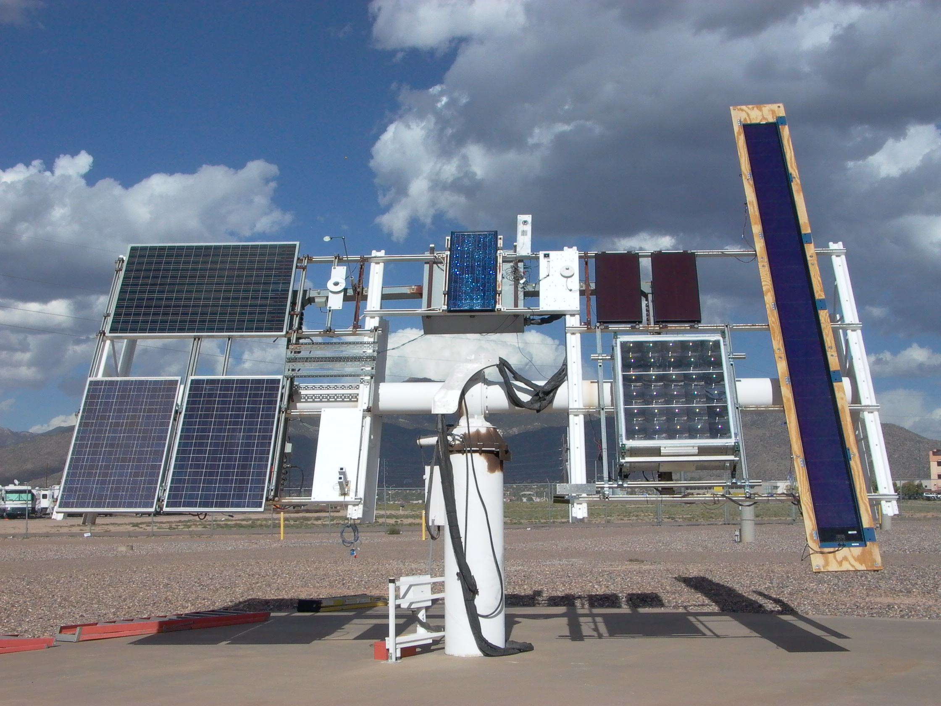
Characterization Methods
Individual modules characterized before and after deployment
Outdoor Tracker Testing
Two-axis solar tracker, modules held normal to sun, 2-4 weeks.
Tracker held on sun from sunrise to sunset, multiple days, clear and cloudy conditions
IV curves measured at 2 minute intervals
Approximately 1000 IV curves minimum
Model Calibration
Sandia Array Performance Model
Semi-empirical model that defines five points on the IV curve
Sub-components affecting performance
  Air mass, f₁(AM) – proxy for spectral response
  Angle of Incidence, f₂(θ)
  Thermal model – ambient to cell temperature

Slide 9
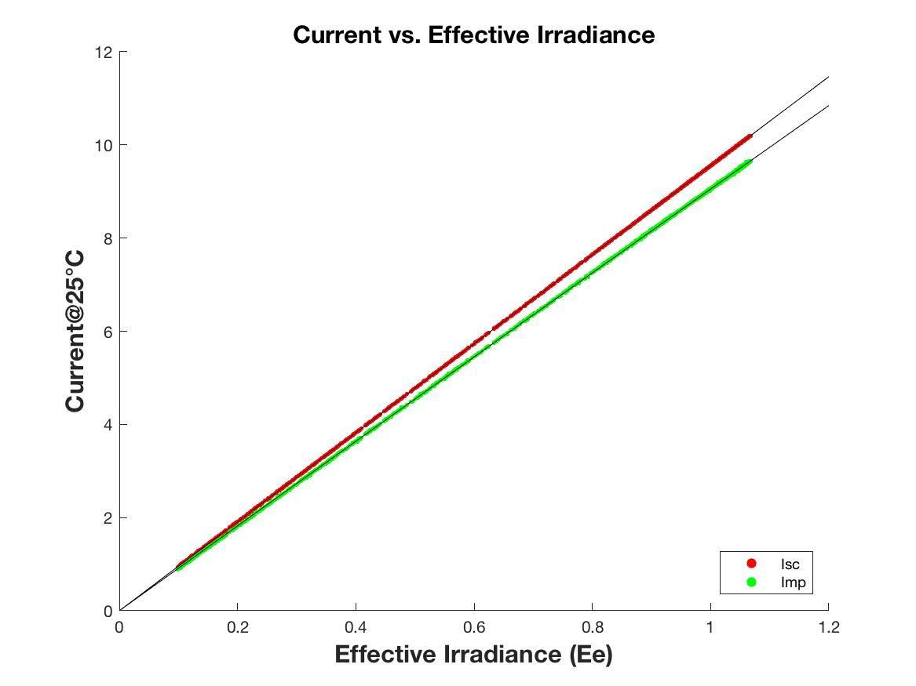
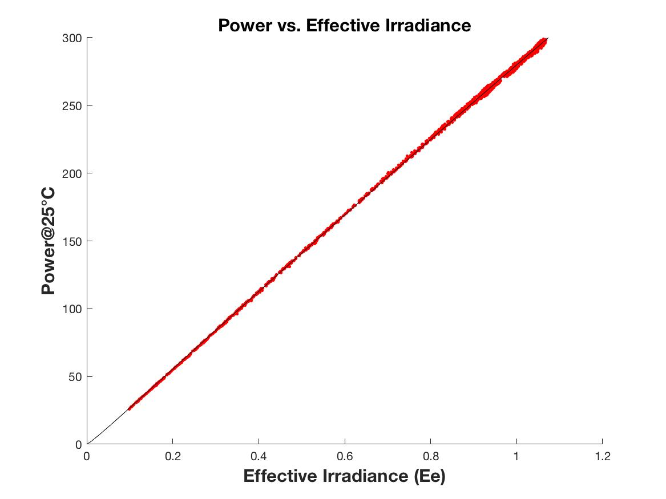
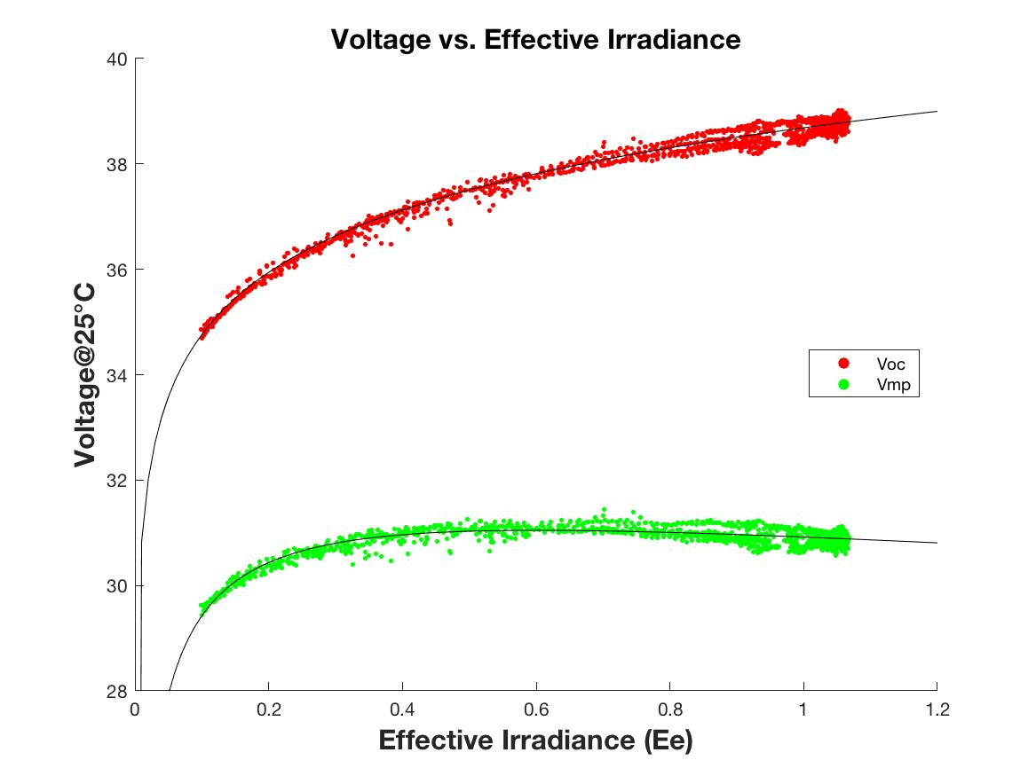
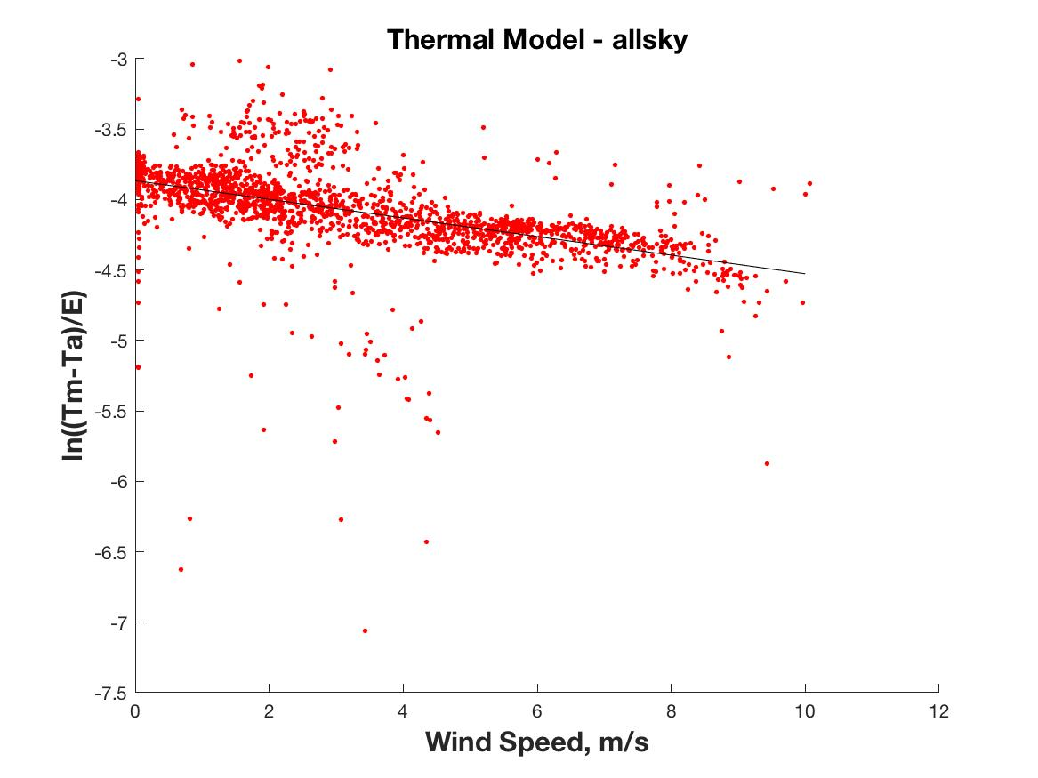
Example Output

Slide 10
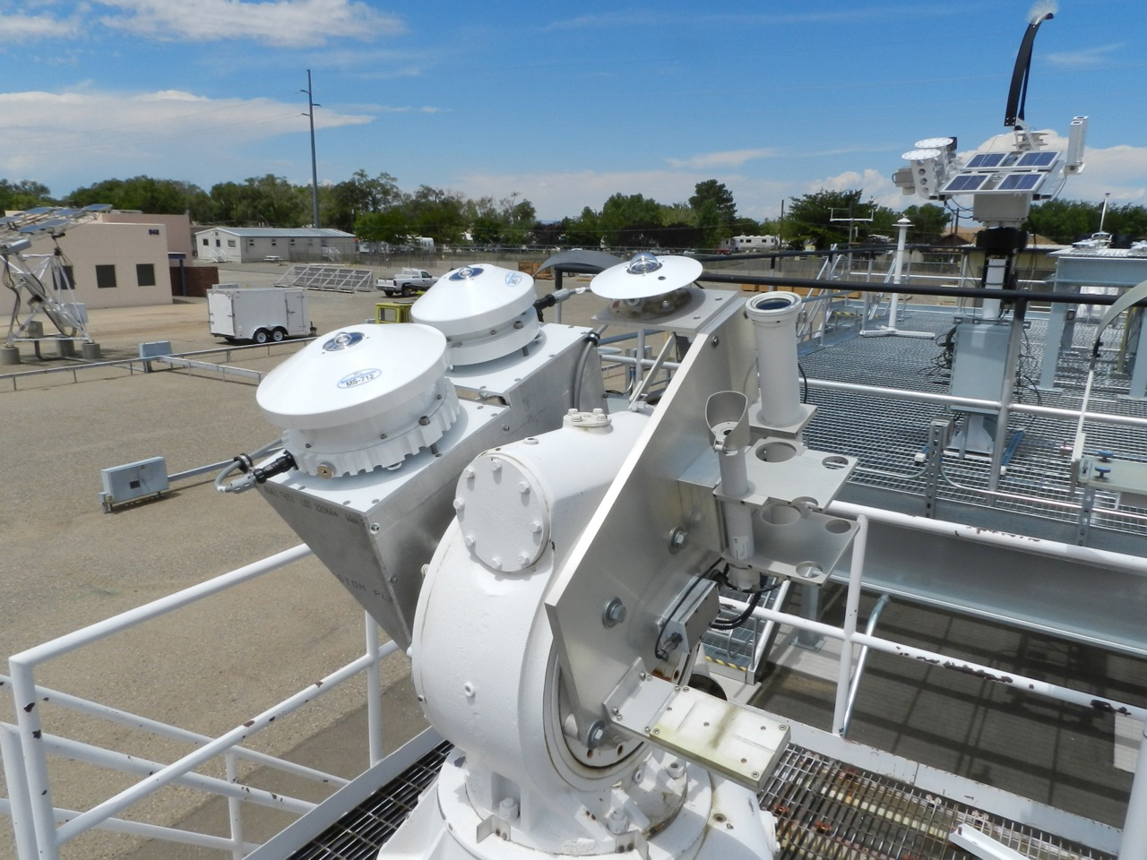
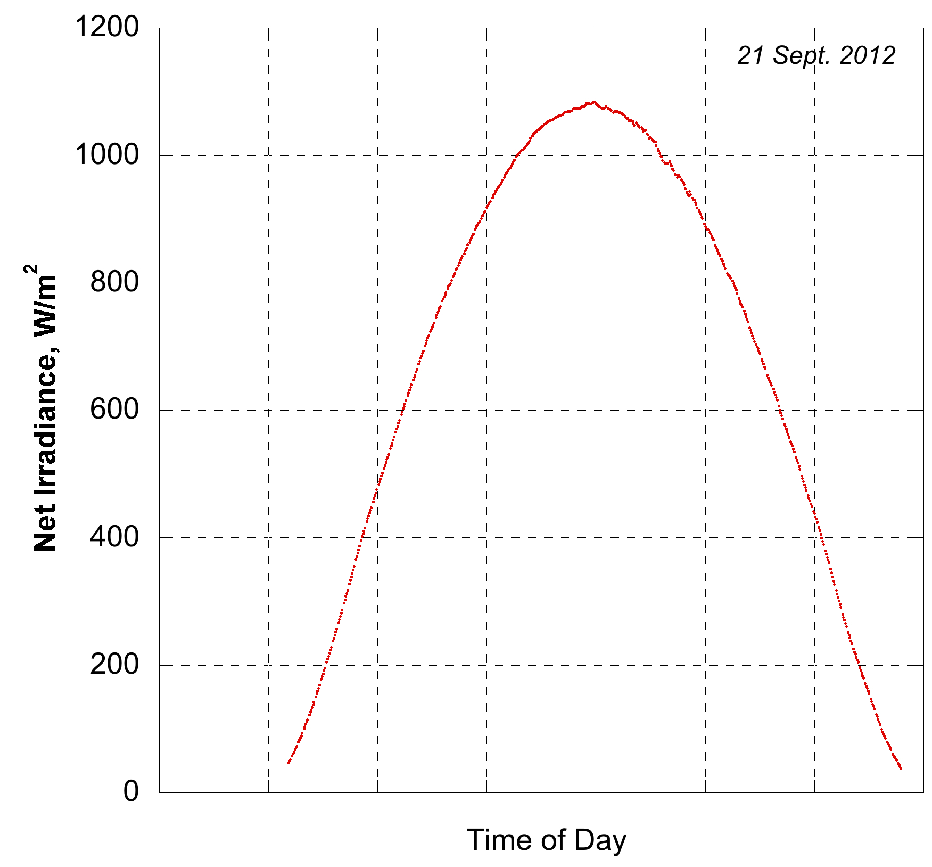
System Performance Modeling
SAPM – use model coefficients calibrated from outdoor tracker testing
Inputs – local weather, irradiance
  1-minute weather files from onsite weather station
  1-minute broadband Plane of Array irradiance (GPOA)
  Apply filters to remove night-time, low irradiance conditions, bad data
Calculate Net plane of array irradiance, corrected for angle of incidence

Slide 11
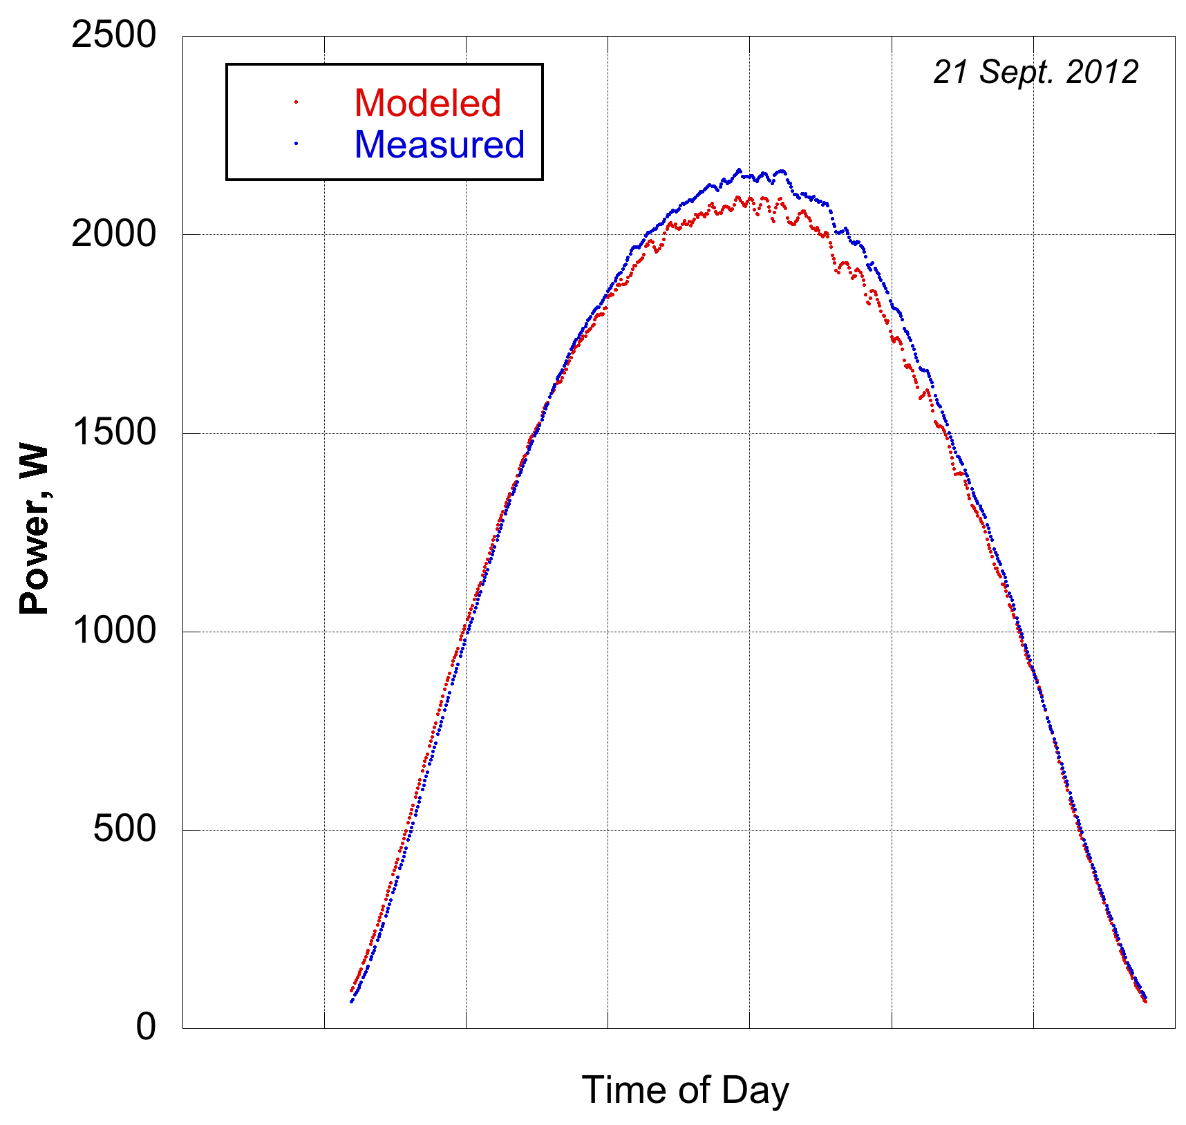
System Performance Modeling
Calculate effective cell temperature from net POA irradiance, ambient temperature and wind speed
Calculate effective irradiance from air mass, net POA irradiance
Calculate current and voltage at max power
Calculate Performance Ratio for period of interest

Slide 12
For the following examples….
E_{e} as determined on previous slide was used for all analysis
P_{mp,STC} determined from tracker testing was used for PR, PR-STC
γ_{pmp} determined from tracker testing was used for PR-STC
T_{module} predicted from wind speed model was used for PR-STC, PR-PPI
I_{mp}, V_{mp} predicted from SAPM were used to for PR-PPI
Effects of snow have not been removed (low array power but reasonable irradiance)
Effect of transient conditions (sudden cloud cover or sudden sunshine) on predicted module temperature have not been considered

Slide 13
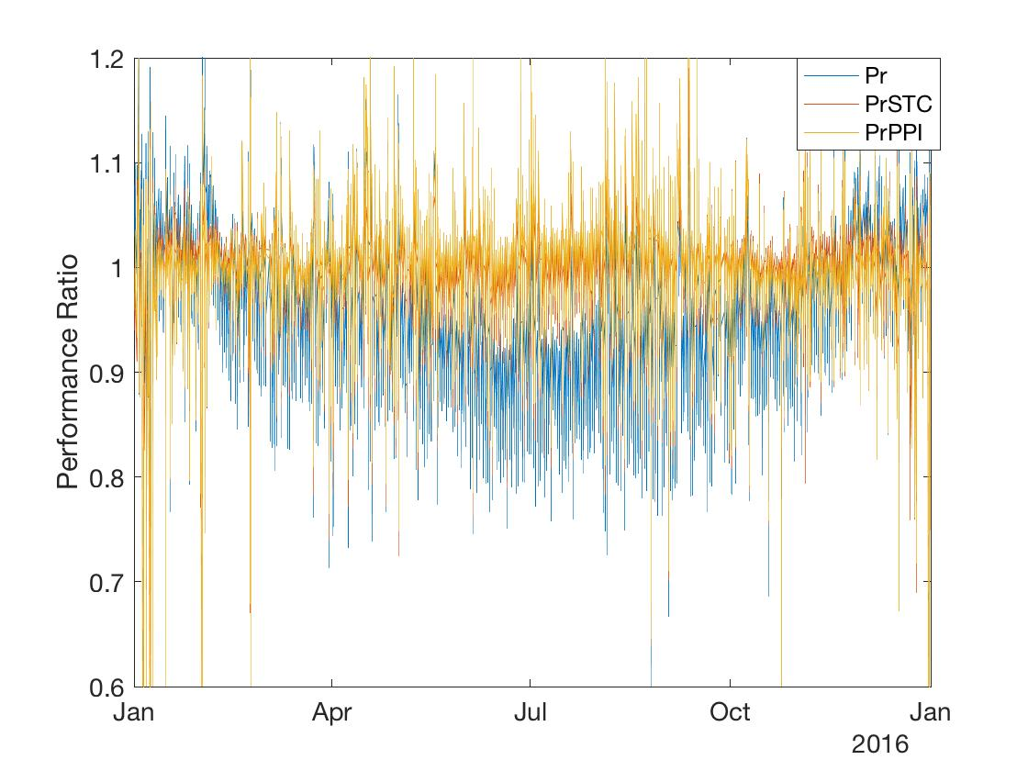
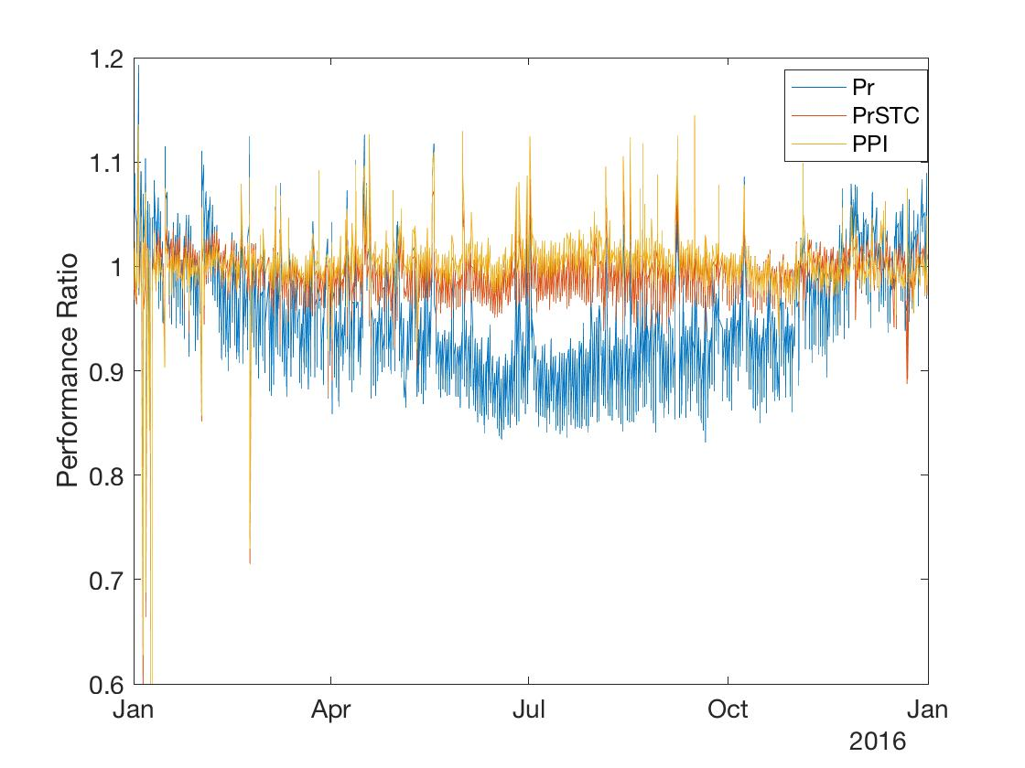
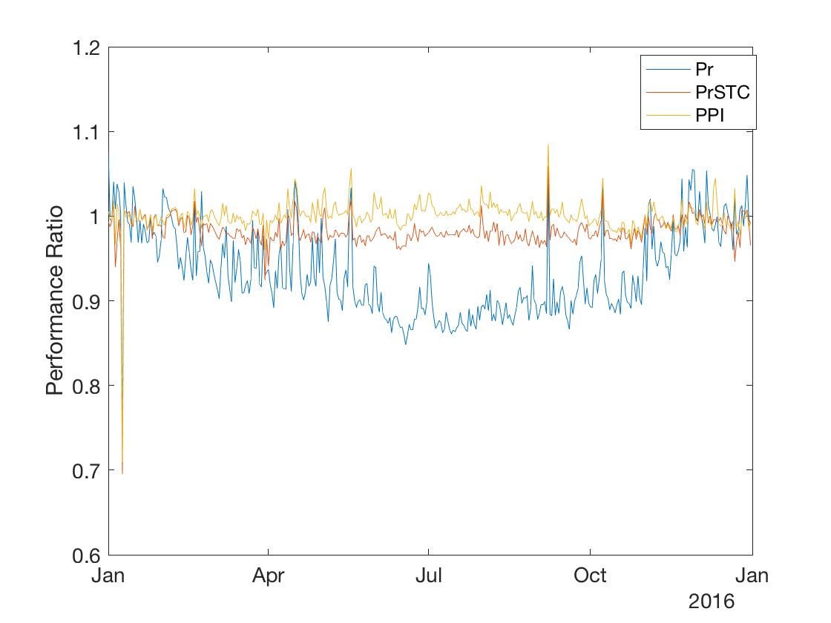
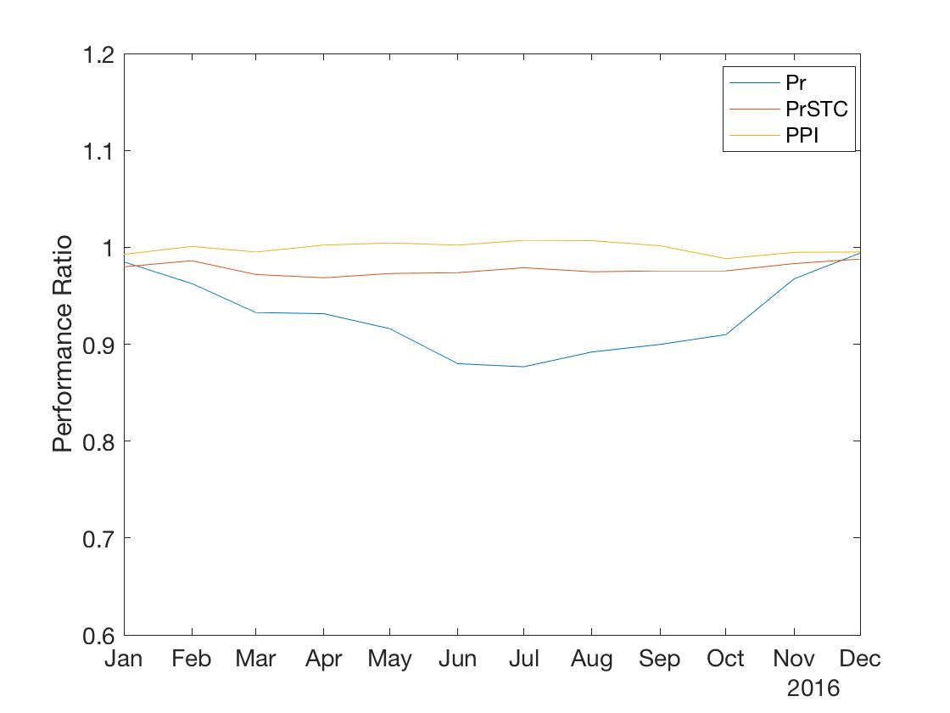
Examples – RTC Baseline Array, 2016 (SNL)
Minutely
Hourly
Daily
Monthly

Slide 14
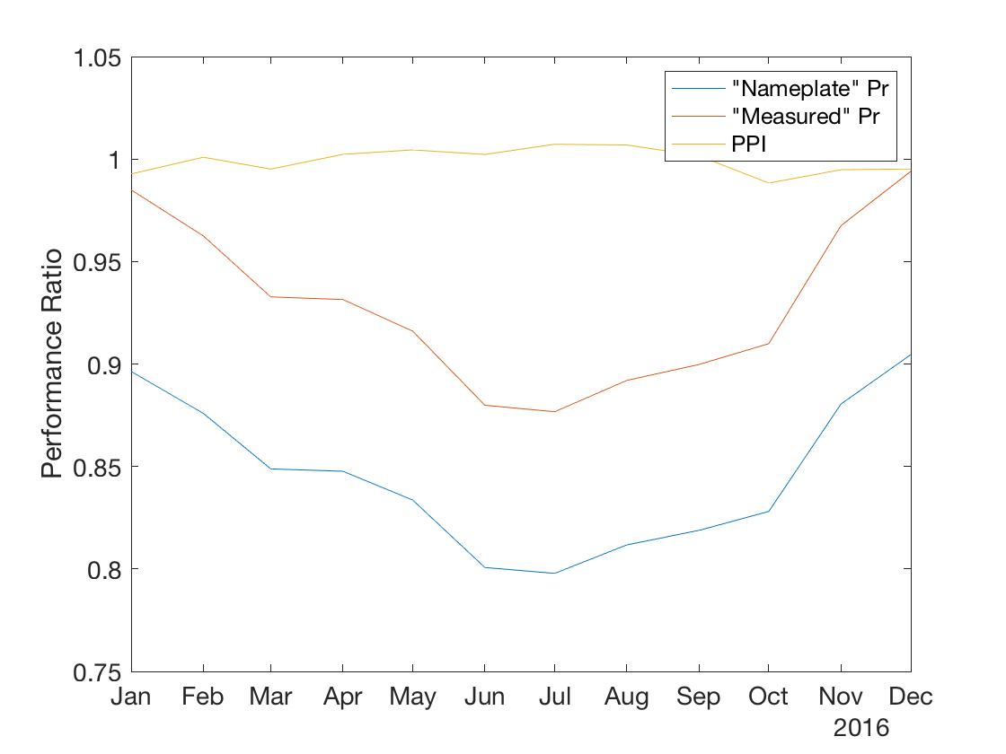
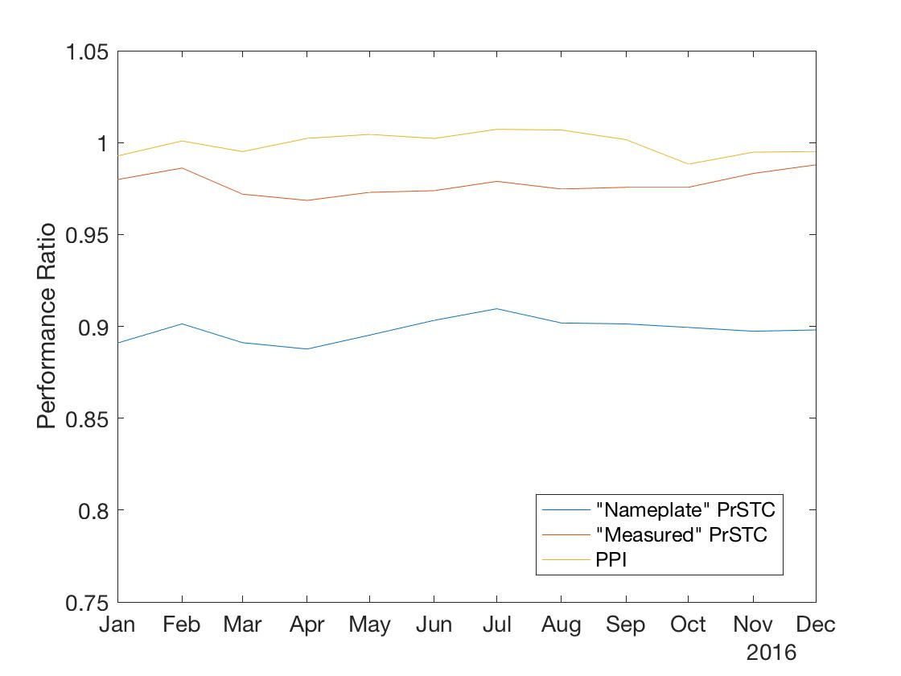
Calibration using “Nameplate” Pmp, γ_{pmp}
Monthly - Pr
Monthly - PrSTC
Both PR and PR-STC are dramatically affected by Nameplate rating
Inaccurate nameplate rating may give the impression of high degradation when in fact the system is performing very well
Still be important to compare to nameplate to validate manufacturer’s performance claims

Slide 15
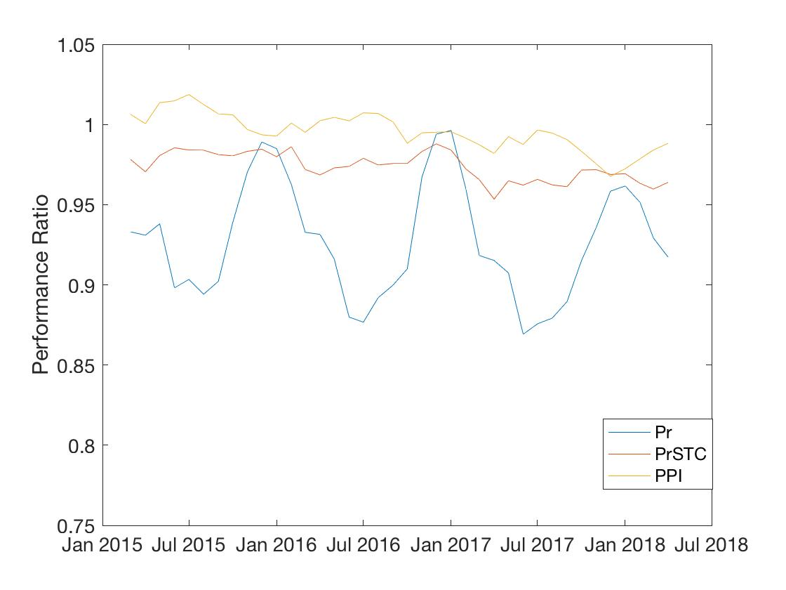
Year-Over-Year – system losses
PR: 0.2%/year. R = 0.05
PR-STC: 0.7%/year, R = 0.68
PPI: 1%/year, R = 0.82
Includes ALL DC losses, including soiling (if any)
Modules currently being flash tested to validate changes from initial characterization
System will be washed when brought back on line to remove soiling
PPI provides highest confidence estimate of system losses

Slide 16
Conclusions
Which method and inputs you use depends on the information and data available.
Using Ee (corrected for AOI and Spectrum) improves performance monitoring methods.
  Requires additional characterization (spectral correction model)
Avoid using nameplate rating if you are planning on comparing performance monitoring results between systems.
  However, using nameplate is valuable if you want to monitor against module warranties.

