Slide 1
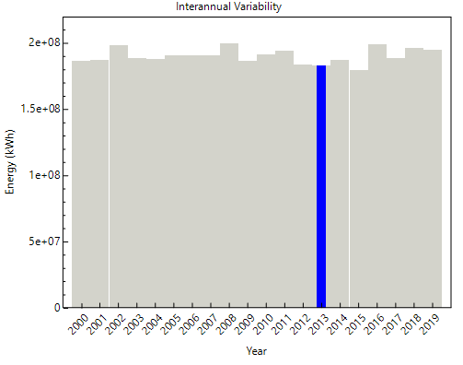
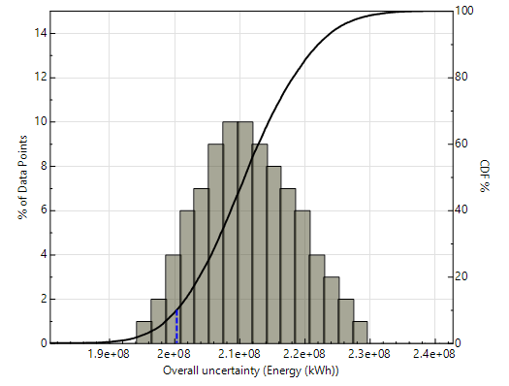
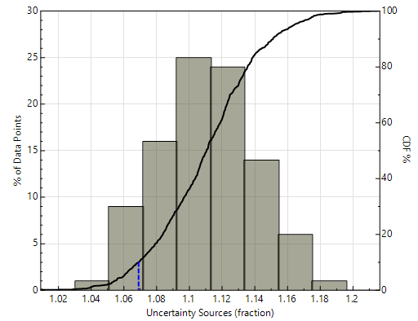
Uncertainty quantification of PV annual energy estimates in the System Advisor Model
Matthew Prilliman¹, Cliff Hansen², Janine Keith¹ , Steven Janzou¹
¹National Renewable Energy Laboratory, Golden, CO, 80401, USA; ²University Sandia National Laboratories, Albuquerque, NM, 87123
Abstract
Uncertainty factors
Uncertainty Modeling in SAM
Uncertainty in photovoltaic (PV) annual energy estimates is a key modeling area in which growth and better understanding is needed. The main concern is a lack of rigorous methodologies for uncertainty quantification that is accepted by the PV industry. Uncertainty in energy production estimates arises from variability of the solar resource, inexact PV performance models and their parameters, and system reliability considerations. Uncertainty in annual energy production is frequently calculated for PV projects to quantify financial risk. Key statistics for energy, such as the P- values “P50” and “P90” are used by financing institutions to calculate the repayment risk for the project. The current methods to estimate these statistics are typically proprietary, specialized, and involve significant post-processing of commercial performance model results. This black-box approach leads to inconsistent P-value estimates from different parties, which reduces investors’ confidence in the results. The new uncertainty quantification methods proposed here offer a standardized methodology in which modeling factors are assigned uncertainty distributions that are then applied in Monte Carlo analysis in conjunction with inter-annual variability analysis (IAV) to generate P-values on annual energy. Separating the uncertainty from modeling factors and the IAV helps to better communicate energy yield modeling uncertainty and leads to better investment decisions. The methodology presented here is available in the 2022.11.21 version of the System Advisor Model (SAM).
Factors chosen based on previous IEA Task 13 work, understanding of model chain for PV annual energy estimates [2]
First-order factors: more impact on annual energy estimates, wider uncertainty distributions
Second-order factors: less sensitivity in annual energy, narrower distributions
Other factors not listed: Effects of snow and soiling loss
Factor distributions can be normal, uniform, triangular distribution, etc.
Uncertainty factor distribution default definitions
System specifications for example uncertainty analysis
Factor | Distribution type | Parameters
Irradiance transposition | Normal | µ = 2.0, σ= 2.5
Horizon shading | Triangular | min.=-1, mode=0, max.=0
Row shading | Triangular | min.=-5, mode=-1, max.=0
Single module rating at STC | Normal | µ = 0, σ= 2.0
Spectral response. | Triangular | min.=-5.7, mode-2.70, max.=0
Inverter availability | Normal | µ = -1, σ= 0.5
Cell temperature | Normal | µ = -2.4, σ= 1.0
Mismatch loss | Triangular | min.=-1.8, mode=-0.8, max.=0
DC wiring | Triangular | min.=-2.5, mode=-1.5, max.=-1
Transformer | Triangular | min.=-2, mode=-1, max.=-0.5
Soiling | Triangular | min.=-1.5, mode=-0.5, max.=0
System Spec | Value
System capacity | 100 MWDC
Tracking | Single-axis tracker E-W
Location | Golden, CO
Weather years | 2000 - 2020
First-order PV annual energy uncertainty factors
First-order factors | Definition
Irradiance transposition | uncertainty in modeling to go from GHI to incident irradiance
Shading (horizon and local) | Modeling of shading effects reducing incident irradiance
Standard test conditions (STC) power | Uncertainty in methods used to get module STC rating
Inverter availability | Lack of knowledge on inverter downtime
P90
Second-order PV annual energy uncertainty factors
Second order factors | Definition
Spectral response | model adjustments based on wavelength of light
Cell temperature | Cell temperature modeling uncertainty
Mismatch loss | Model of mismatch of performance within string or array
Electrical loss | Voltage losses from wiring or transformer losses
Aleatory uncertainty results
Methodology
Separate the uncertainty in PV annual energy estimation into two categories: aleatory uncertainty and epistemic uncertainty
Aleatory uncertainty : uncertainty stemming from the randomness of variables that cannot be better known or understood. The main source for this category is inter-annual variability (IAV) in weather data across years.
Epistemic uncertainty : uncertainty from modeling parameters, data, and model equations that can theoretically be improved through improvements in models or more accuracy in data measurement.
Epistemic uncertainty is estimated with factors for each modeling component that represents uncertainty in annual energy estimates due to each factor
Factors are treated as a distribution that are then sampled through Monte Carlo methodology and applied to a base annual energy value to generate a distribution of annual energy values for base weather year [1]
Process is repeated for n weather years provided by modeler with same factor distribution set
Results show impacts of aleatory and epistemic uncertainty separately along with the combined uncertainty and Pxx probability of exceedance values
Ground irradiance measurement uncertainty was quantified as part of this project, normal distribution on annual energy ranges from mean [-0.4%, 0.4%] and std. dev. [0.35%, 0.6%] [3]
Bifacial modeling uncertainty (view factor approach) distributions on annual energy found to be [-.04%, .04%] mean and [.08%, .22%] std. dev [4].
P90
Combined uncertainty results
Discussion
Probability of exceedance results (blue lines)
P90
Would you consider incorporating the SAM methodology presented here into your modeling workflow?
Which uncertainty factor do you struggle the most to quantify? Are there factors not listed here that we should consider?
P90 value | Value
Combined uncertainty | 2.00394e8 kWh
IAV uncertainty | 1.83029e8 kWh
Factor uncertainty fraction | 1.06918
Epistemic uncertainty results
References
[1] Prilliman, Matthew J., Clifford W. Hansen, Janine M.F. Keith, Steven Janzou, Marios Theristis, Aaron Scheiner, and Ellis Ozakyol. 2023. Quantifying Uncertainty in PV Energy Estimates Final Report. Golden, CO: National Renewable Energy Laboratory. NREL/TP-7A40-84993. https://www.nrel.gov/docs/fy23osti/84993.pdf.
[2] Reise, C. , Müller, B. 2018. Uncertainties in PV System Yield Predictions and Assessments. Intl. Energy Agency Report IEA-PVPS T13-12:2018. ISBN 978-3-906042-51-0.
[3] Hansen, C., Scheiner, A. 2022. Uncertainty in Annual Energy Resulting from Uncertain Irradiance Measurements. Proc. of the 49th IEEE Photovoltaic Specialist Conference, Philadelphia, PA.
[4] Prilliman, M., Keith, J. M. F. 2022. Uncertainty Quantification of Bifacial Performance Modeling. Proc. of the 49th IEEE Photovoltaics Specialists’ Conference, Philadelphia, PA.
This work was authored in part by the National Renewable Energy Laboratory, operated by Alliance for Sustainable Energy, LLC, for the U.S. Department of Energy (DOE) under Contract No. DE-AC36-08GO28308. Funding provided by the U.S. Department of Energy’s Office of Energy Efficiency and Renewable Energy (EERE) under the Solar Energy Technologies Office Award Number DE-EE0008168. The views expressed in the article do not necessarily represent the views of the DOE or the U.S. Government. The U.S. Government retains and the publisher, by accepting the article for publication, acknowledges that the U.S. Government retains a nonexclusive, paid-up, irrevocable, worldwide license to publish or reproduce the published form of this work, or allow others to do so, for U.S. Government purposes.
PV Performance Modeling and Monitoring Workshop
Salt Lake City, Utah
5/9/2023 – 5/10/2023
NREL/PO-7A40-86169

